Slide 1
Conbotics Operation Manual

Slide 2
Capabilities & Limitations
Capabilities & Limitations
  Short wall: 3.2m vertical – 2.5m min
  Inner/outer corner
  Maximum pressure in the pneumatic system: 8bars
  Pressure in airless device: 150-170bars
  Weight: 140kg
  PainterRobot with extended arm 1230 x 900 x 1915 mm
  PainterRobot with retracted arm 1230 x 892 x 1945 mm

Slide 3
Basic Operations
Turn on the robot
1. Turn the system ON
2. Release brakes (green button once)
3. Boot up PC and Jetson (green button 5s)
Turn off the robot
1. Hold the green button for 8s
Emergency button
1. Cuts power to motors (red button)
2. Release by turning it
3. Release brakes (green button)

Slide 4
Preparations
Prepare the airless device for a paint job
1. Place a full paint bucket and dip in the inlet tube
2. Set the airless device to 150-170bars
3. Turn the black knob to face leftward
4. Ensure the airless device only pumps liquid. Not air.
5. Spray manually until you achieve smooth paint flow.
6. Ready to paint.
Prepare the robot for a paint job
1. All the previous plus,
2. Initialize
3. Drive the robot close to the corner
4. Create the room plan, or/and edit the configurations of the room
5. Start robot.
Prepare the room for a paint job (fake walls)
1. Add fake walls that can cover +-30cm around the height of the lidars.

Slide 5
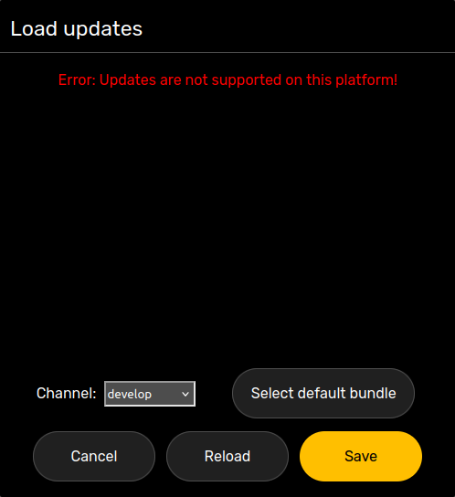
Tablet Usage
Change tablet UI version
  Navigate to the first page of the app
  Menu > App Settings > Load updates > Reload or,
  Select an update channel or,
  Add an update channel by tapping the '+' option and typing in the name of the channel (eg 'testing', 'develop', 'singapore')

Slide 6

Tablet Usage
Connection status
Battery
Paint litres
Proximity status
Cameras status
Lock/unlock
N/A
Undo / Redo
Settings

Slide 7
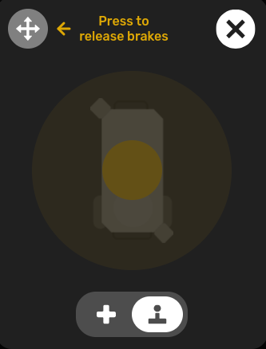
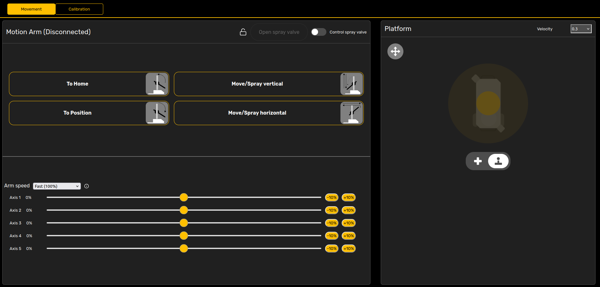
Tablet Usage - Movement
Move the arm
  Either each axis separately, or,
  Move the arm to a specific predefined position
Move the base

Slide 8
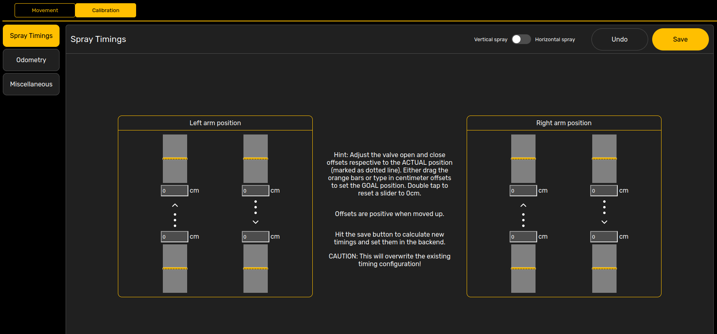
Tablet Usage - Maintenance
Calibrate timings
  Menu > Maintenance > Calibration > Spray timings (vertical / horizontal)

Slide 9
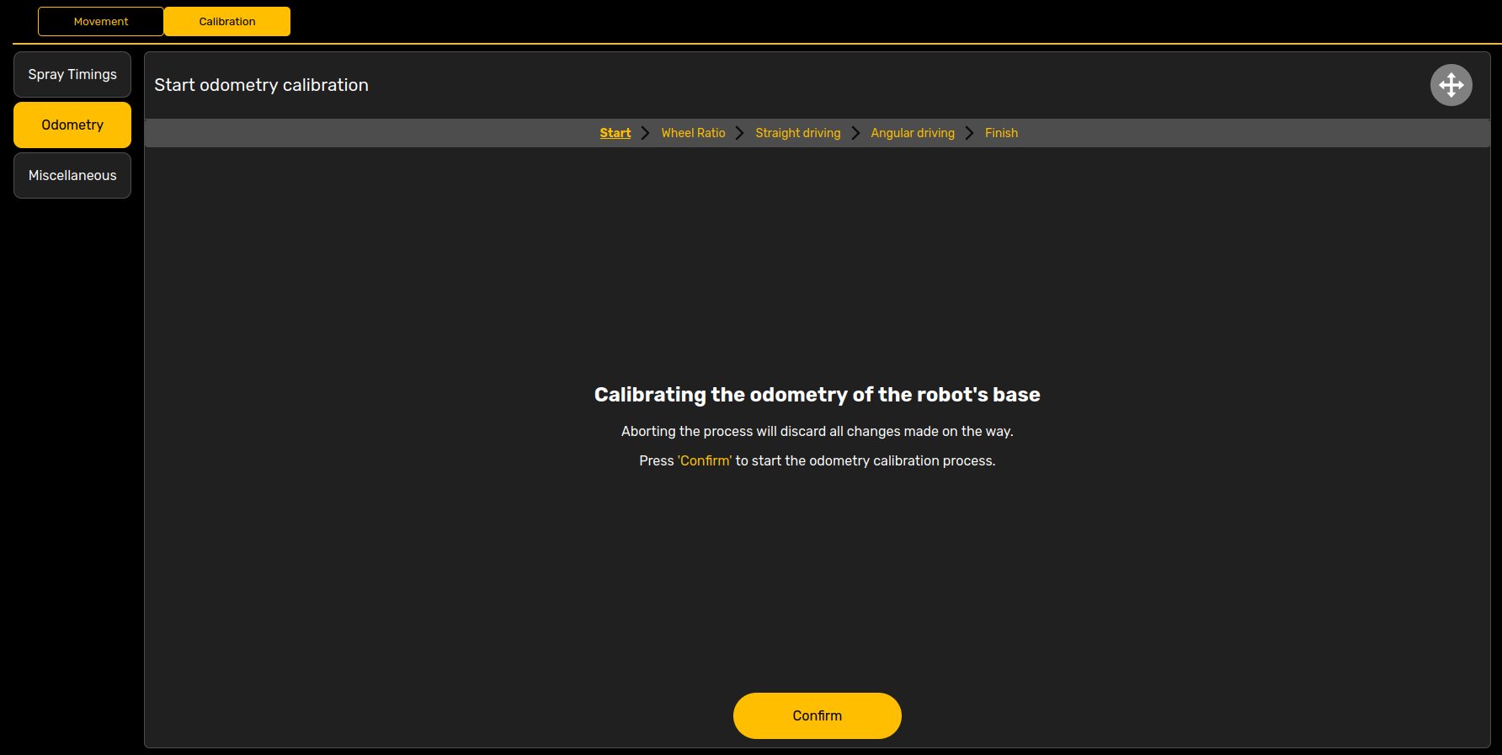
Tablet Usage - Maintenance
Calibrate odometry
  Menu > Maintenance > Calibration > Odometry, or
  Well... ask someone

Slide 10
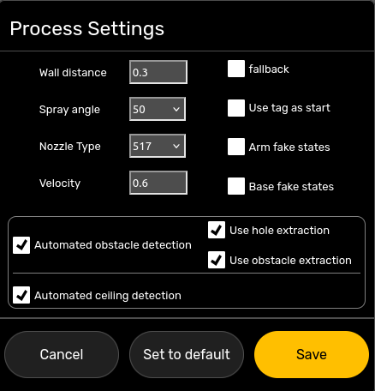
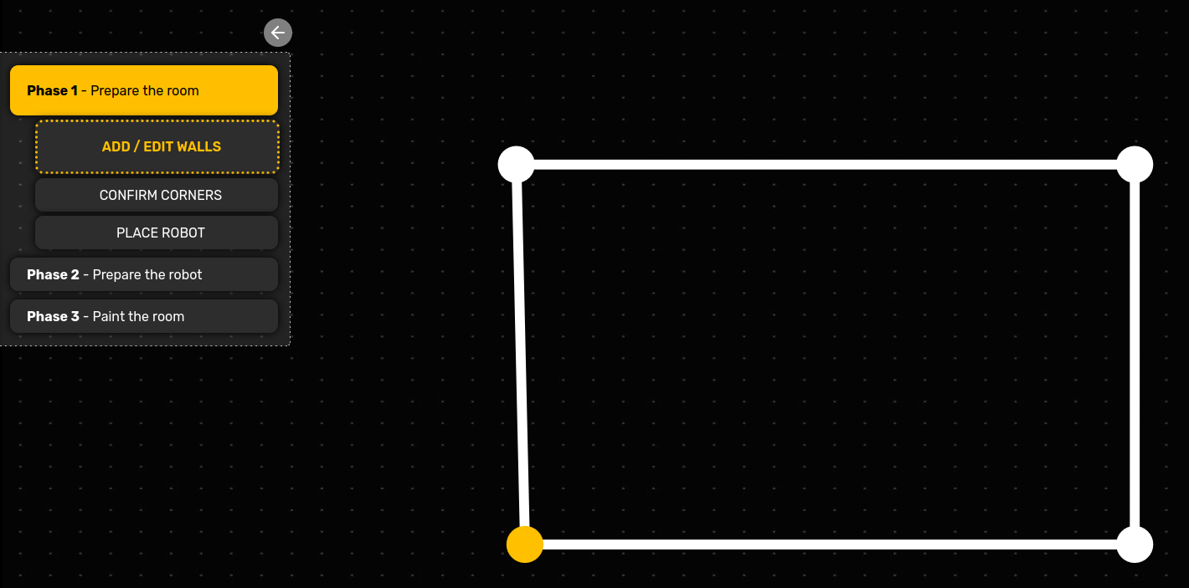
Tablet Usage – Create room plan
Add a points for corners, in a clockwise fashion
Use Menu > Room Settings > flip function if needed
Configurations (Menu > Process Settings). Make sure wall distance is the desired one

Slide 11
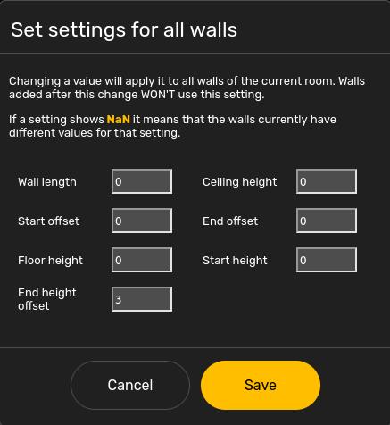
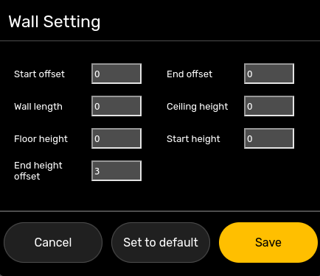
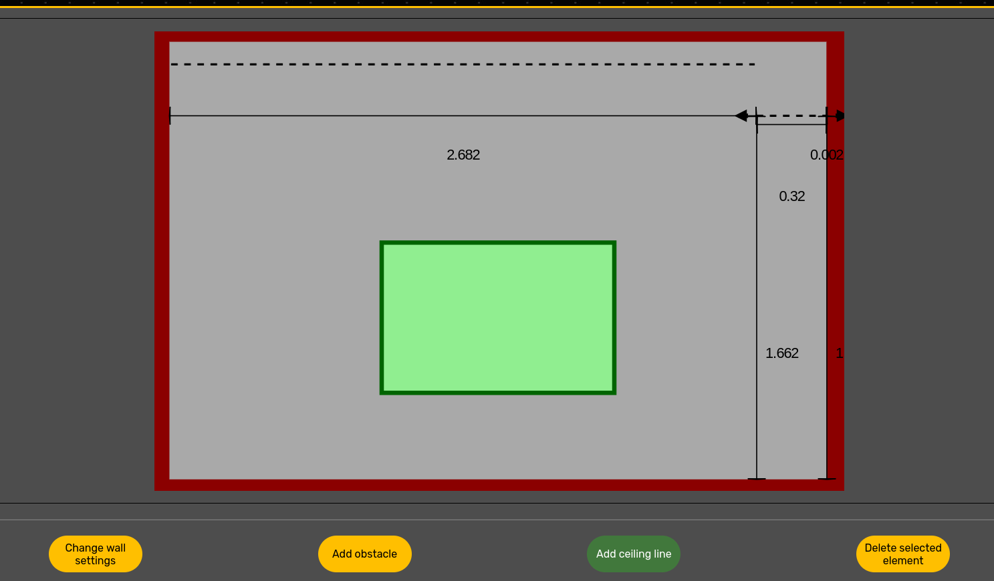
Tablet Usage – Create room plan
Add margins / offsets (Menu > Room settings > Settings for all walls)
Add obstacles (Select the wall > Obstacles)
Change wall settings (Select the wall > Change wall settings)
Note: A ceiling line must start exactly in the beginning/end, or where the previous line finished

Slide 12
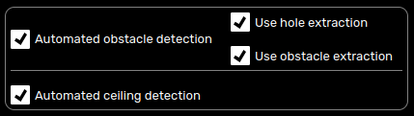

Tablet Usage – Process Mode
Menu > Process Settings > un/tickautomated obstacle/ceiling detection
Click on a wall > Change wall settings > Apply wall length/height in process
There are two modes to distinguish:
Automatic mode: We just draw the layout of the room (eg 4 corners). We start the process, and the robot does the rest.
Semi-automatic mode: On top of the previous step, we also have to set the exact dimensions and characteristics of the room (width, length, obstacles, holes)

Slide 13
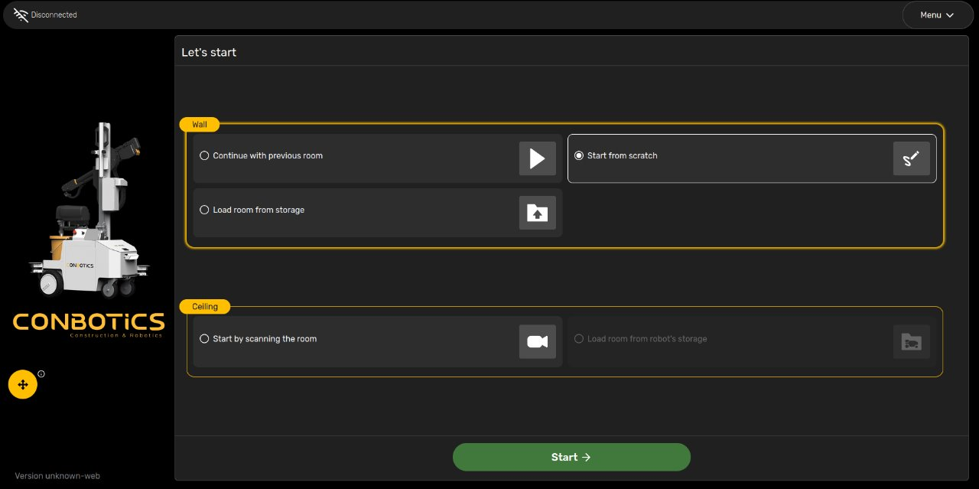
Tablet Usage – Wall Process
Choose 'Start from scratch' to make your own room plan, or 'Load room from storage' to load a previously saved one, or 'Continue with previous room'
Draw the room plan. Make sure all the dimensions/obstacles/door and window gaps are correct if you are using semi-automatic mode. Otherwise just create the boundaries of the room (eg rectangle)

Slide 14
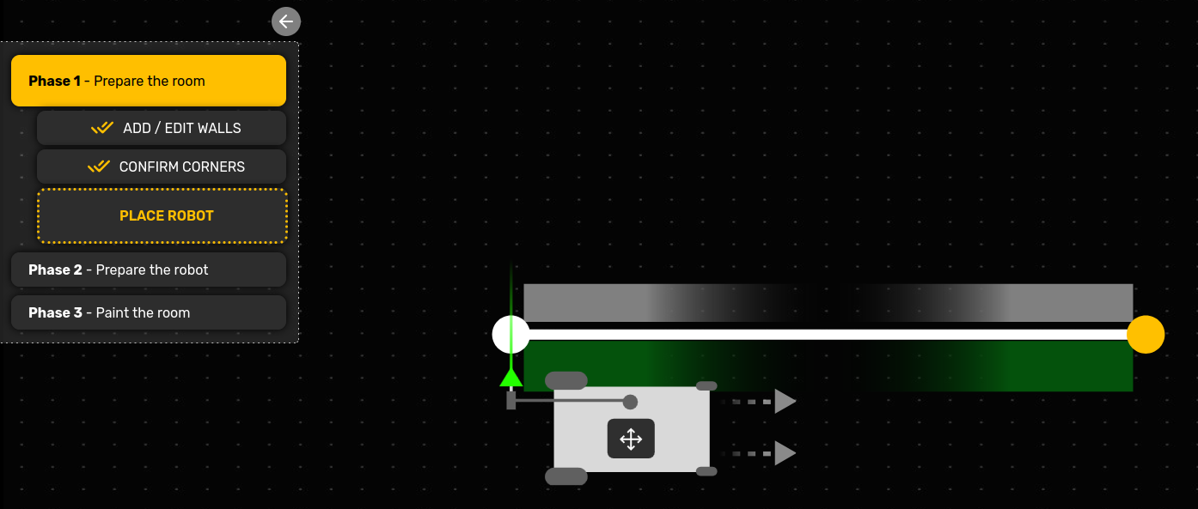
Tablet Usage – Wall Process
3. Make sure all the configuration (wall distance, automated ceiling/obstacle detection un/checked etc)
4. Initialize
5. Drive the robot close to the corner position
6. Configure inner/outer corners
7. Choose a start corner
8. 'Start robot'

Slide 15
Tablet Usage – Wall Process
After that, it will prompt to start the initialization drive.
After this is done as well, we are good to go
'Start spraying' is the last step before the robot starts moving and painting.
Note: At any time, you may Pause or Stop the process, on the top/right corner

Slide 16
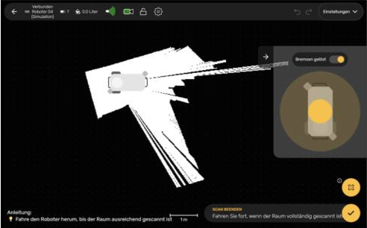
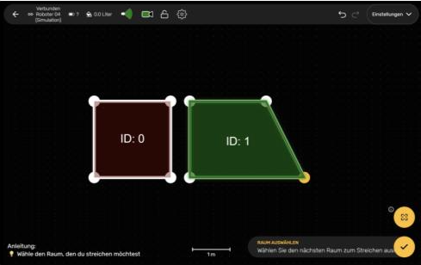
Tablet Usage – Ceiling Process
Do a ceiling paint process
  Choose 'Start by scanning the room'
  Wait until the room is scanned, and verify its layout
  Choose the starting corner, and drive close to it
  Press the tick and eventually 'Start robot'

Slide 17
Tablet Usage – Emergency
In case of emergency
Press stop on tablet: The robot will stop after it finishes the current task (eg after wall change)
Press the emergency button: The robot will stop immediately
  To bring back to normal, release the button, and release brakes again (green button)

Slide 18
Software – Monitoring
Login to the robot and jetson locally (ssh)
1. Connect to the robot via WiFi (eg MR04)
2. Connect to the robot PC (passwords in Keepass):
3. Connect to jetson:
ssh –X –A conbotics@10.11.12.10
ssh –X –A conbotics@10.11.12.10

Slide 19
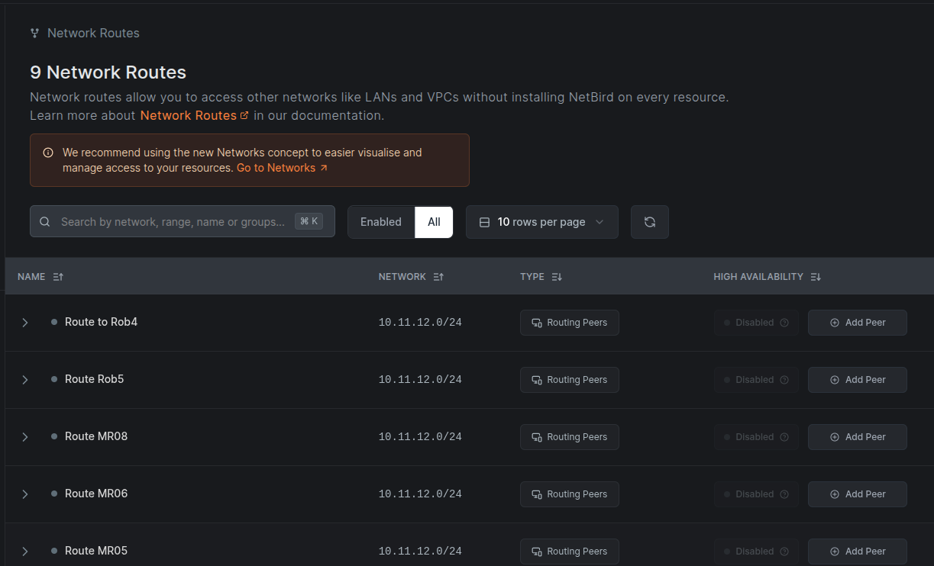
Software – Monitoring
Login to the robot and jetson via netbird
1. Browse to netbird portal: https://app.netbird.io/
2. Check that in "Peers" the robot is online
3. Enable the netbird on that robot in "Network Routes"
2. Connect to the robot PC:
3. Connect to jetson:
ssh –X –A conbotics@10.11.12.10
ssh –X –A conbotics@10.11.12.40

Slide 20
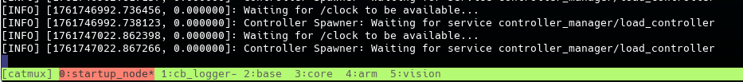
Software – Monitoring
Check the tmux session: Here you can find error notifications about the robot/process
1. Login to the robot with the previous methods
2. Type in a terminal:
cattach

Slide 21
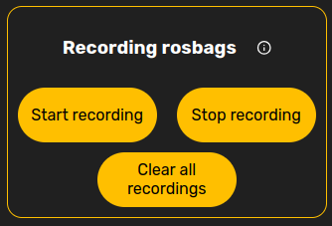
Software – Monitoring
Record rosbags
  Either from the tablet, or
Copy rosbag on our laptops
  Either wait for the blue led after plugging in a syncable USB, or
rosparam set /config/general/user/record_rosbag true
python3 src/cb_bringup/scripts/record_rosbag.py
Lsblk –f #Identify usb
sudo mkdir /mnt/usb
sudo mount -o uid=1000,gid=1000 /dev/sdb1 /mnt/usb
sudo rsync -ah --info=progress2 --remove-source-files ~/rosbags/2025-07-31*.bag /mnt/usb/
(maybe add --no-owner --no-group)
sudo umount /mnt/usb

Slide 22
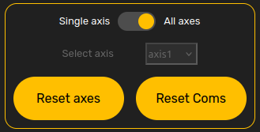
Troubleshooting
Common troubleshooting
  Reinitialize
  Restart the robot
  Reset axis: Especially if the robot is in a non-normal position, reset axis:
    Deinitialize
    Menu > Maintenance > Calibration > Miscellaneous > Reset axis
    Initialize
  Shut down, replug the cables of the arm cabinet, restart, reinitialize

Slide 23
Troubleshooting
Common troubleshooting
  Clean lidars: Often the robot stops, without any tablet indication. At that moment perhaps lidars need cleaning
  Camera / Corner alignment failed: After you initialize, drive the robot forward/backward for a better creation of the map of the room.
  Planning arm failed: Sometimes just pressing OK is sufficient.
  . kills and restarts the startup node and catmux session
  . if initialization failed, check which nodes were not initialized
robce
rostopic echo /missing_nodes

Slide 24
Clean your sh...
1. Exchange the paint with a water bucket
2. Empty the remaining paint into the paint bucket
3. Place the primer into an empty bucket
4. Turn the black knob downwards and flush water (manual button or via tablet) until the primer is cleaned
5. Turn the black knob leftwards and flush water (manual button or via tablet) until the intake tube and rest hoses are cleaned
6. Remove and soak the nozzle and filters in solvent.

Slide 25
Software – Advanced – git
Update branches
1. Ensure VS Code is configured to use Git and remote connections (download Remote-SSH and Git Graph extensions)
2. In VS Code, open the Source Control tab on the left (Ctrl+Shift+G) to check the graph for each branch
3. Update if needed
4.
5.
git checkout BRANCH && git fetch OR git pull
makeros OR catkin build
robce

Slide 26
Software – Advanced - rviz
Check rviz
  On your laptop
export ROS_IP=10.11.12.10 # or whatever the IP of the robot is
export ROS_MASTER_URI=http://10.11.12.10:11311
rviz

Slide 27
Software – Advanced – Hard reset axis
Hard reset axis: When the robot is stacked in an abnormal position, and neither reinitialize, or tablet's reset axis work, then we have to do a hard reset. From the terminal, run the following command:
Then follow the guidelines, to release one by one the arm motor axis.
When you release a motor, one person must physically hold the arm from falling from the corresponding motor movement.
After the brakes are released, manually put the arm into (home) position, for all the axis.
Re-initialize
./cb_tools/sprayarm_axis_reset/reset_axes_script.py

Slide 28
Conbotics User Self-Test
Prepare the robot for a paint job
Turn on the robot.
Bring the robot arm 'in position', then back to home.
Reset axis and reinitialize
Create a room plan for semi-automatic mode. One of the walls should contain a window and a beam.
Drive the robot to the starting position, and start the process
While the robot is operating, adjust the vertical timings
Clean the robot

